Slide 1
Customer behavioral segmentation and profiling

Slide 2
Project aim
The charity group is interested in using data science tools to design marketing strategies aimed at determining the appropriate target group and profiling the behavioral patterns of its members. The goal is to design and implement advertising campaigns. The expected outcomes of this project are:
Segmentation of Members: Based on donation history and behavioral indicators, members can be divided into several manageable groups. This segmentation will reveal the current behavioral patterns of the members.
Target Market Identification: By understanding the behavioral patterns, the charity group can select suitable behavioral patterns for campaign implementation.
Profiling Members: Exploring the relationship between initial member information (such as gender, age, etc.) and identified behavioral patterns. This profiling will provide insights into key characteristics of potential benefactors, helping the charity group in targeting and engaging with them effectively.

Slide 3
Transaction data Preprocessing
EDA (Y data profiling )
Filter the data
Aggregate the transaction data
EDA on aggregate data
Categorize and score the data

Slide 4
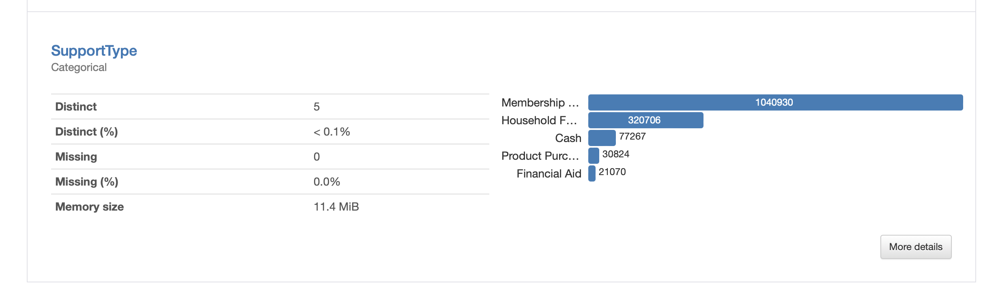
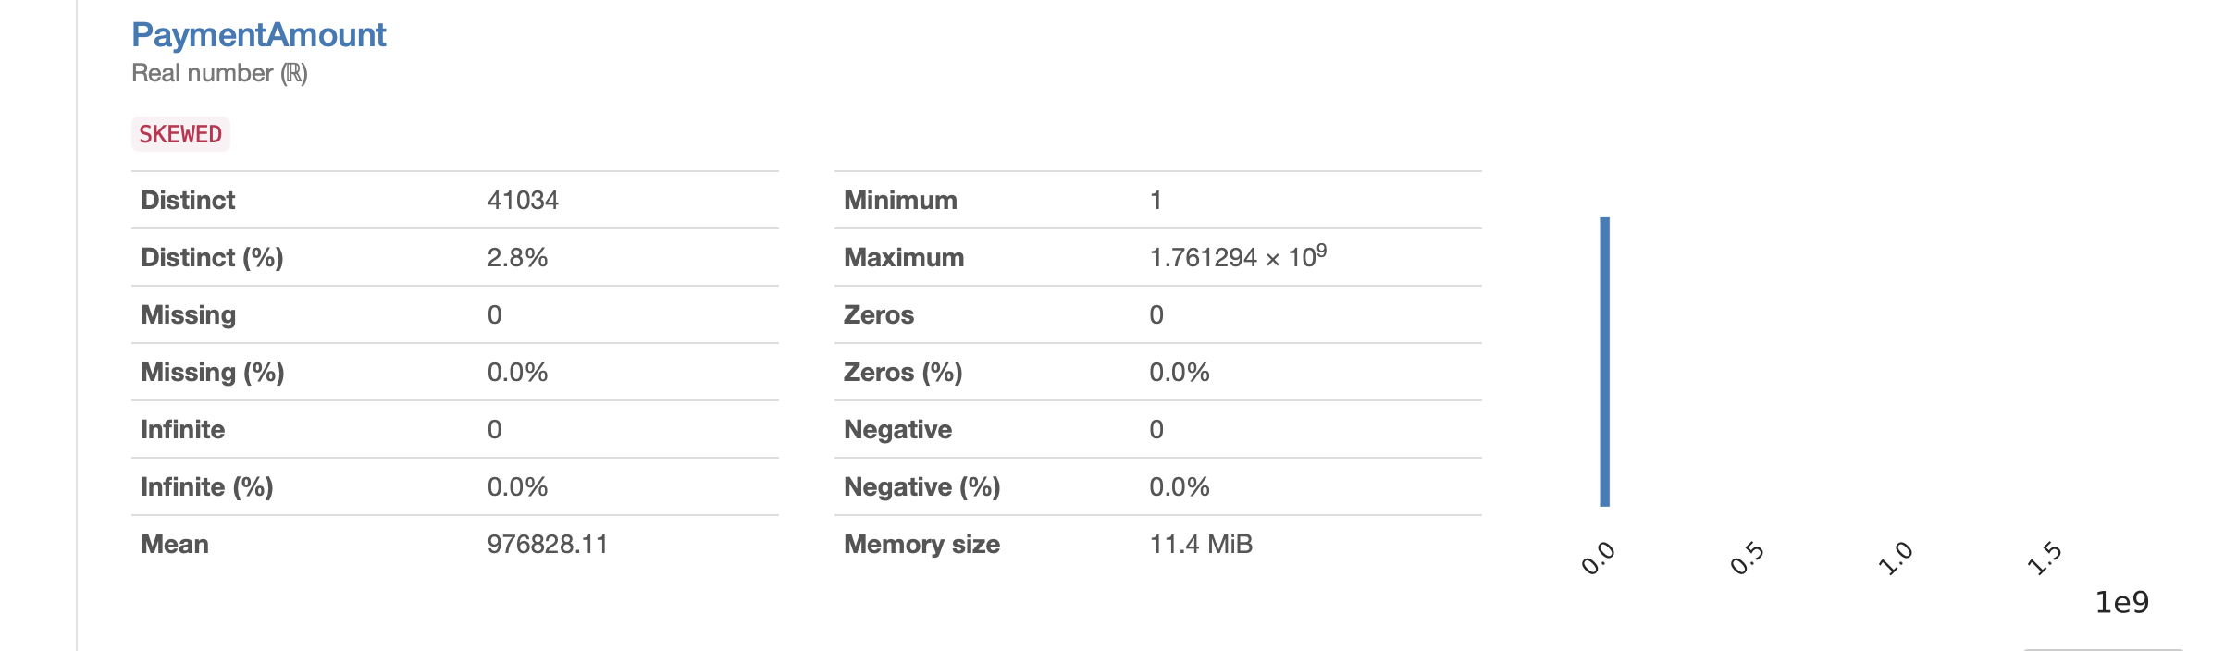
EDA on transaction data
Membership category is selected to be analyzed
Because on each category we can do process of analyzing and different category has different behavioral pattern so we can’t mix them up.
The payment amount is skewed it is inflated on value close to zero

Slide 5
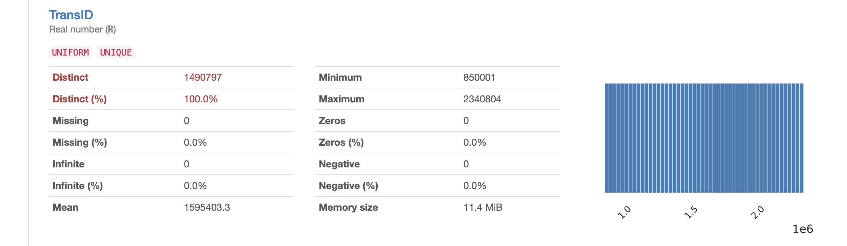
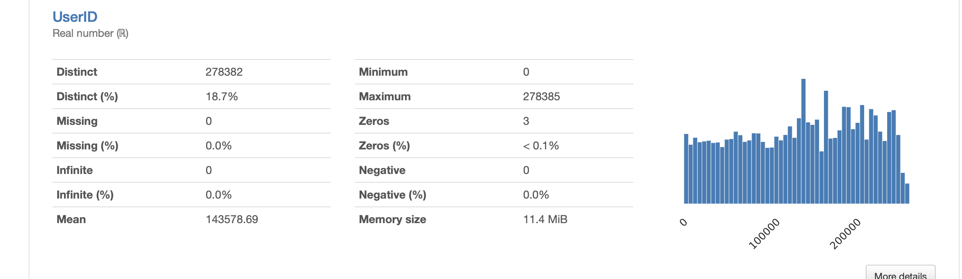
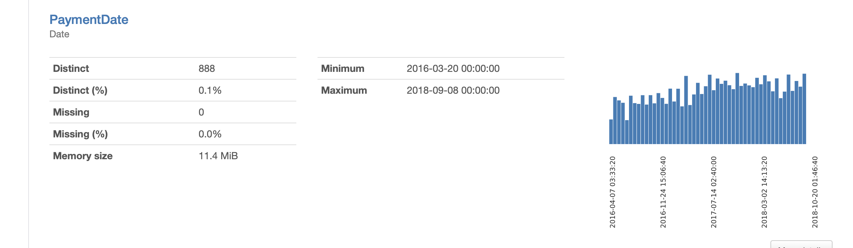
EDA on transaction data
Transaction ID and User ID are unique there is not any missing values in these columns
The payment data column is Date format we should change it to different format as
%Y-%m-%d

Slide 6
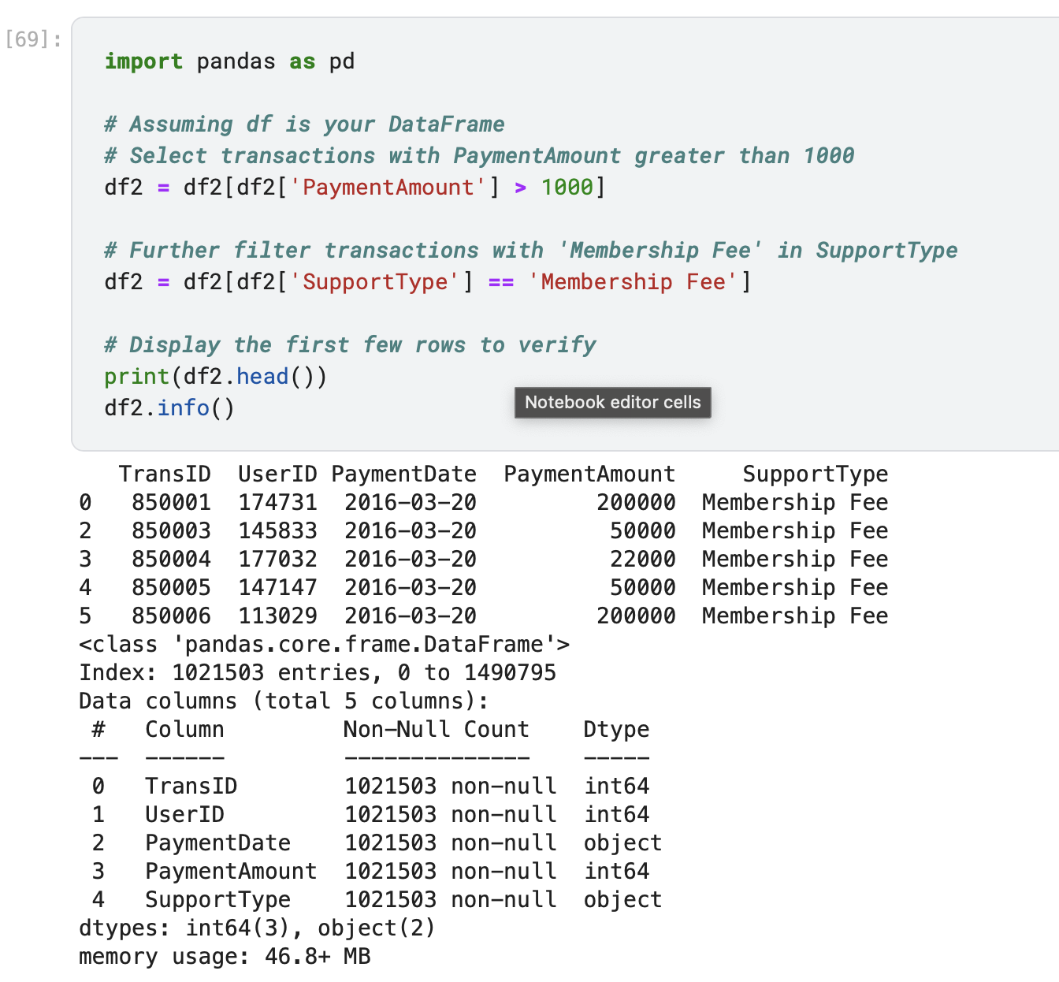
Filter the transaction data

Slide 7
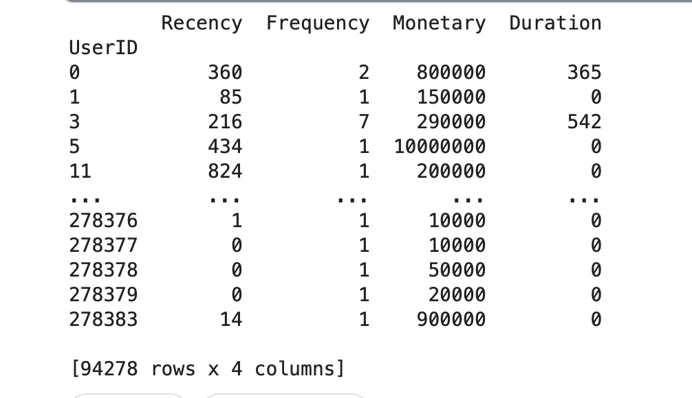
Aggregate transaction data
First, we should aggregate the data by user ID and payment information to eliminate repeated transactions within the same day.
Then we should aggregate on User ID to calculate the number of times (frequency) each user has done the transaction
Recency : I subtract max Transaction data of payment date from each payment data.

Slide 8
Aggregate transaction data
Monetary : we sum up the money each user spend each time
Duration : for each user we have min transaction data and the max one so when we subtract them, we reach to duration

Slide 9
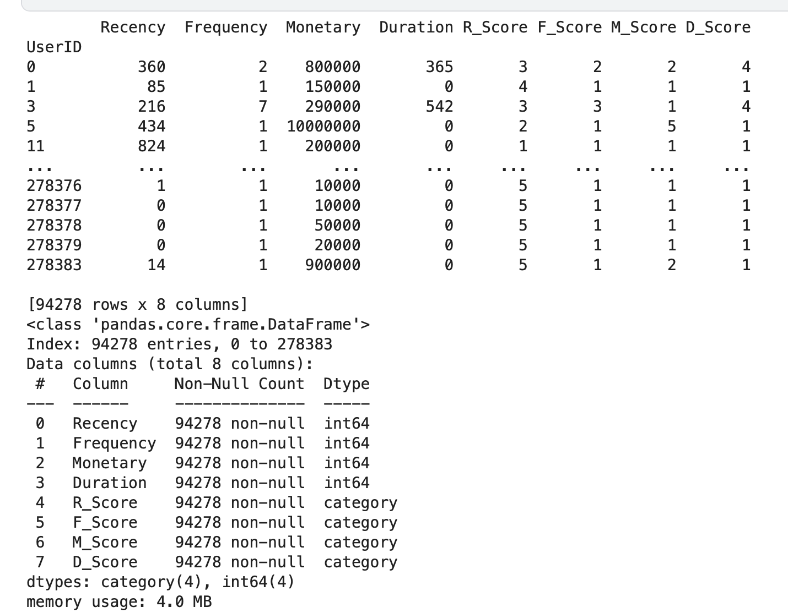
Categorize and score the data
We score RFMD using a scale of 5 to 1 for recency and 1 to 5 for the other factors. For recency, smaller values are more valuable, whereas for metrics like frequency, larger values indicate higher importance.

Slide 10
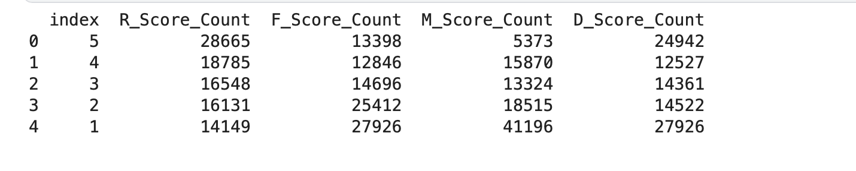
EDA on RFMD
Here is the distribution of RFMD scores in scale 5 to 1

Slide 11
Benefactors data Preprocessing
EDA (Y data profiling )
Extract and calculate age
State classification
Handling missing values

Slide 12
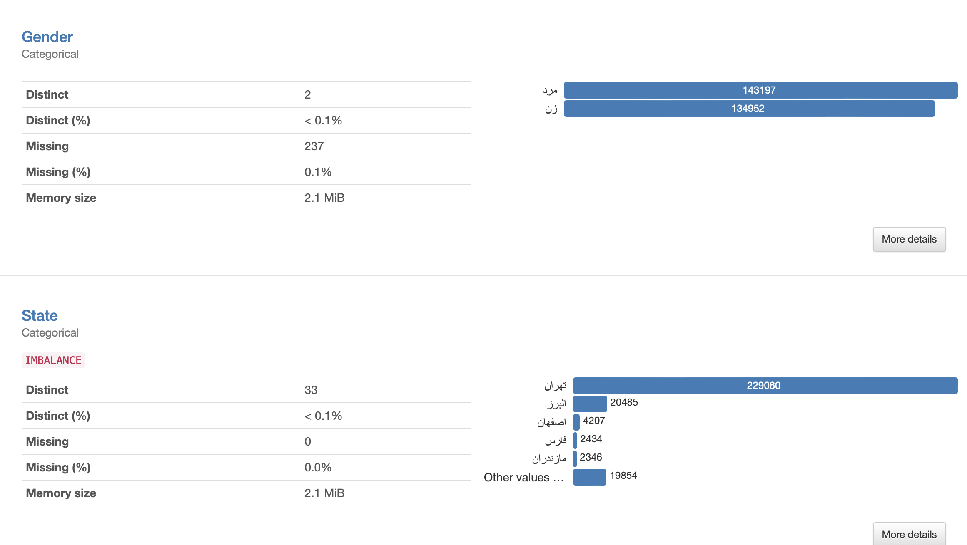
EDA on Benefactors data
Gender column has 237 missing values, and the State column is imbalanced

Slide 13
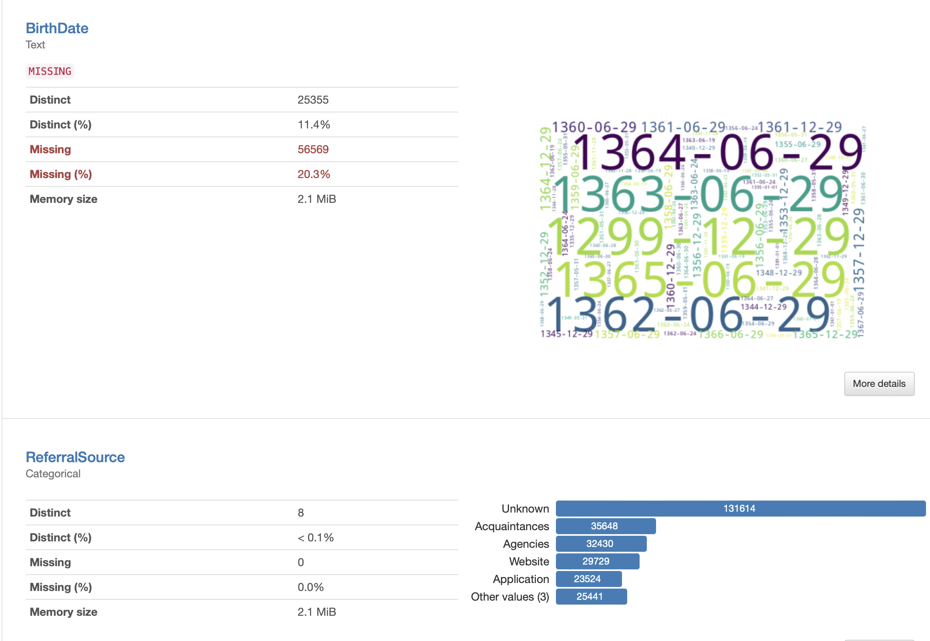
EDA on Benefactors data
20 percent of birthdate is null
Number of rows with missing values in at least half the columns: 111

Slide 14
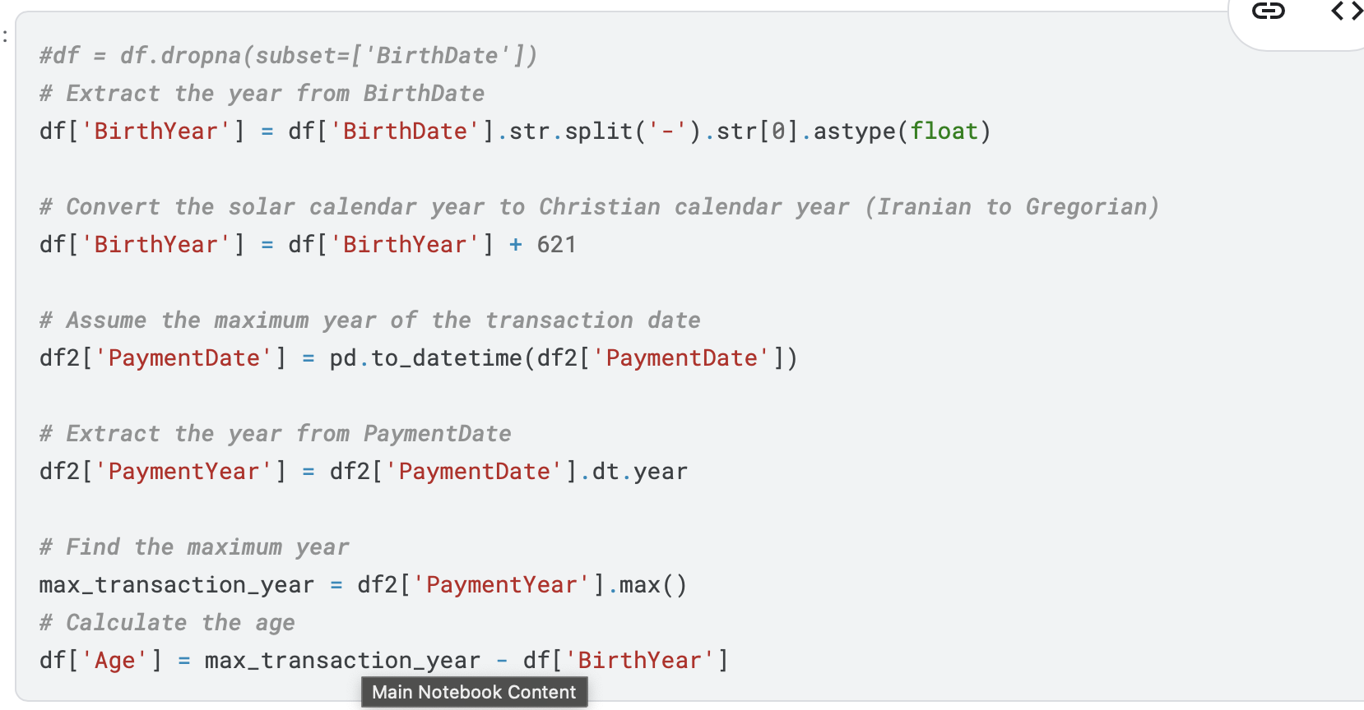
Calculation of birth year
If we want to select the accurate age, we should find the max transaction date for each customer.

Slide 15
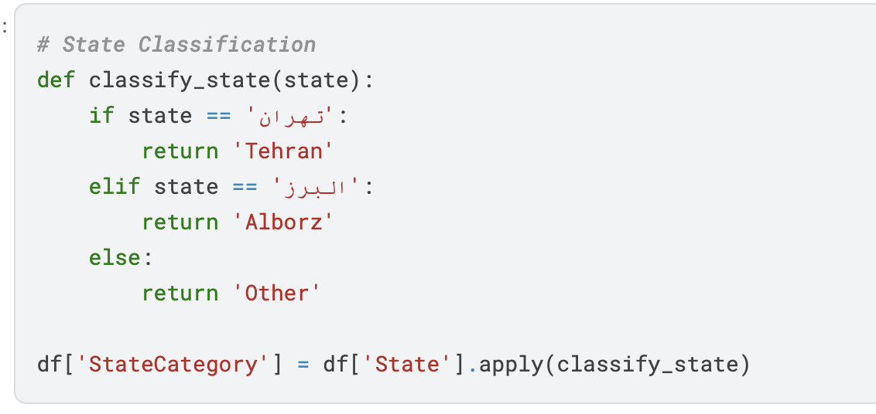
State classification
We did translation and, we divide the state in 3 categories as Tehran Alborz and Others .

Slide 16
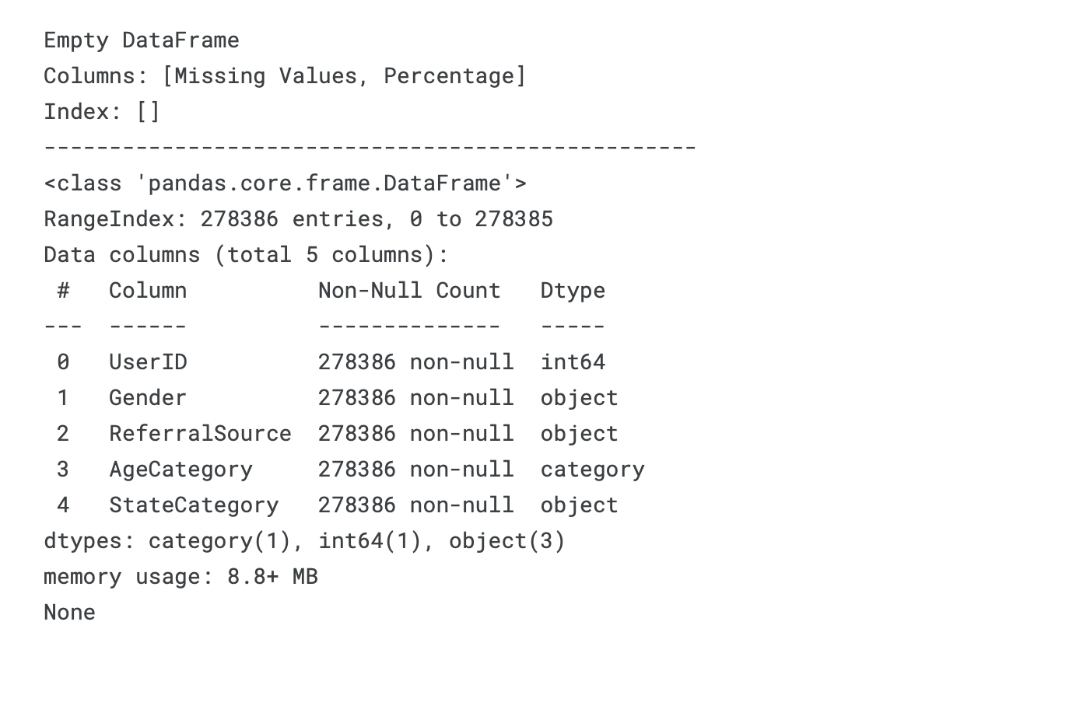
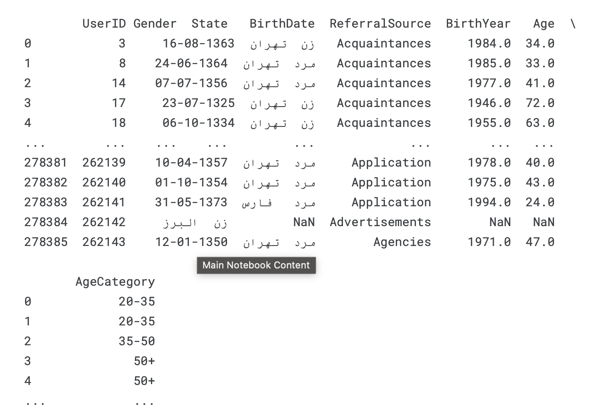
Missing values handling
Missing values in birthyear column: we convert birthyear to categories (0-20 , 20-35 , 35-50 , 50+) then we impute null values with KNN imputer (k = 3)
Missing values in gender column : we use mode( most frequent values ) to impute null values

Slide 17
Data modeling
Cluster 1: High-Value Loyalists
Behavior Summary: These are the most valuable and loyal customers, highly active with frequent purchases and significant spending.
Cluster 2: New or Inactive Prospects
Behavior Summary: These customers show low engagement, make infrequent purchases, and have moderate value. They may be new or in need of re-engagement.
Cluster 0: Steady Spenders
Behavior Summary: These are moderately valuable customers with occasional purchases and consistent engagement, offering growth potential.
Cluster 3: At-Risk customers
Behavior Summary: These customers are at high risk of churning, with low engagement, infrequent purchases, and short durations of activity.
Cluster 4: High-Potential customers
Behavior Summary: These customers have high spending potential but exhibit low engagement and activity, indicating a need for targeted re-engagement strategies.

Slide 18
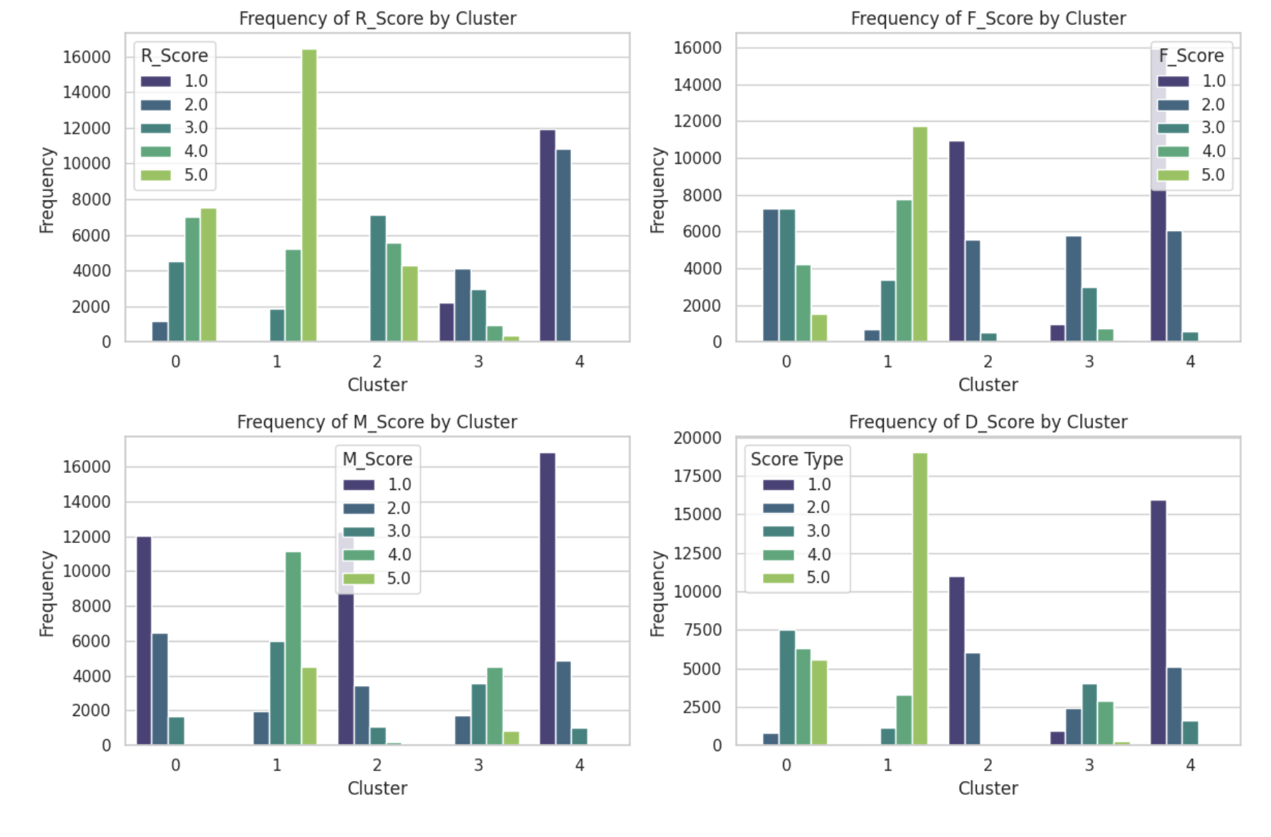
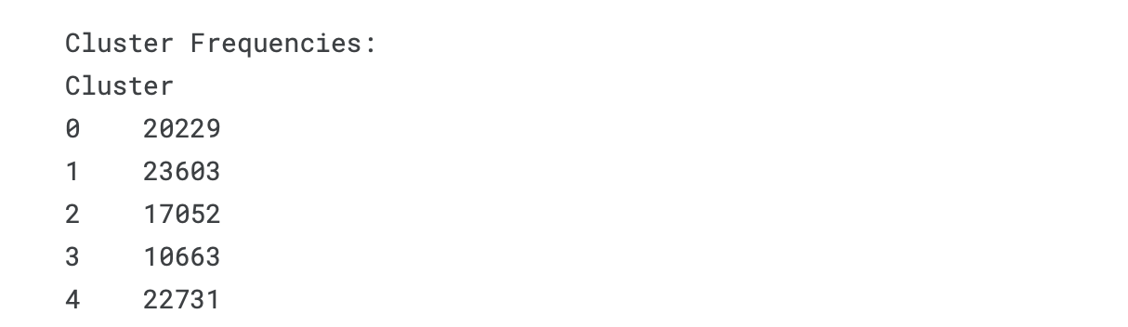
Data modeling
Loyal customers

Slide 19
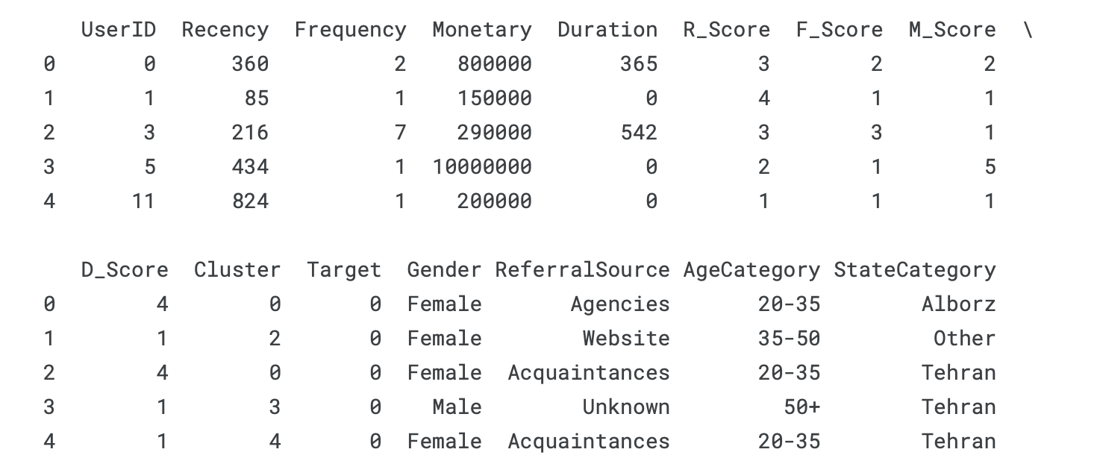
Merging two dataframe
We should merge benefactors and transaction data merged on user id

Slide 20
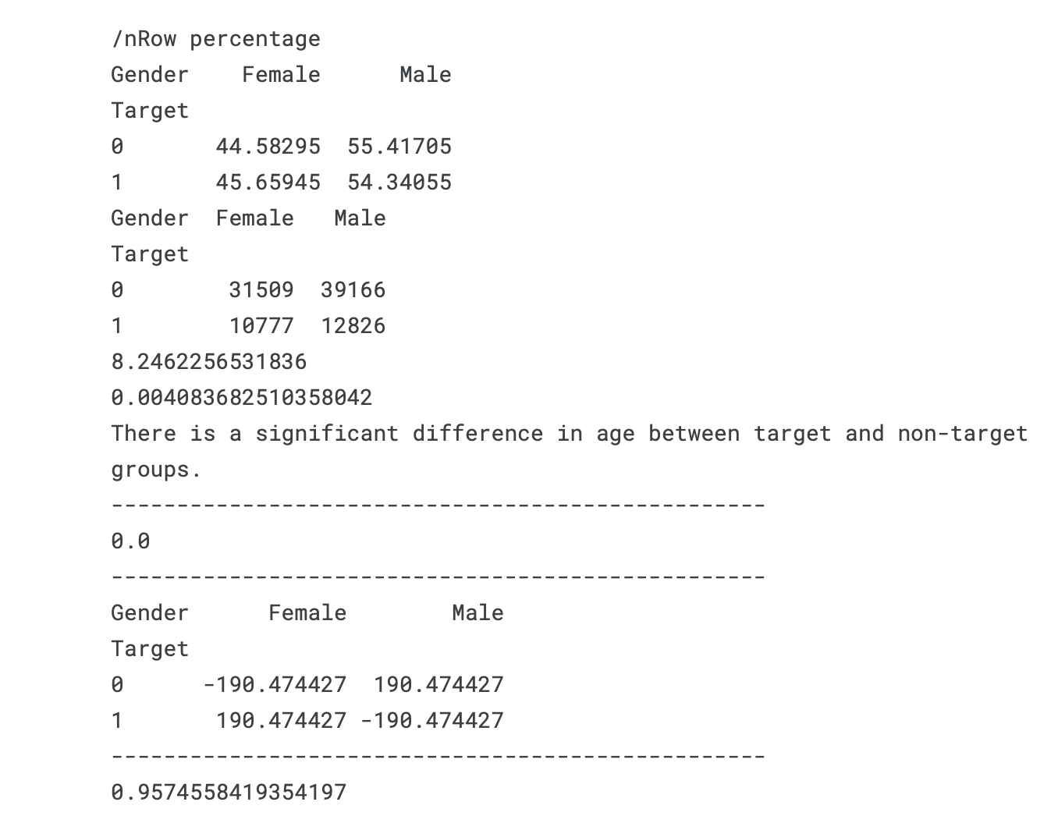
Test on gender
Chi square test : 8.24
P-value : 0.004
Residuals:
The observed vs. expected counts show deviations, particularly for both females and males:
For Target = 0: Female residual: -190.47, Male residual: +190.47
For Target = 1: Female residual: +190.47, Male residual: -190.47

Slide 21
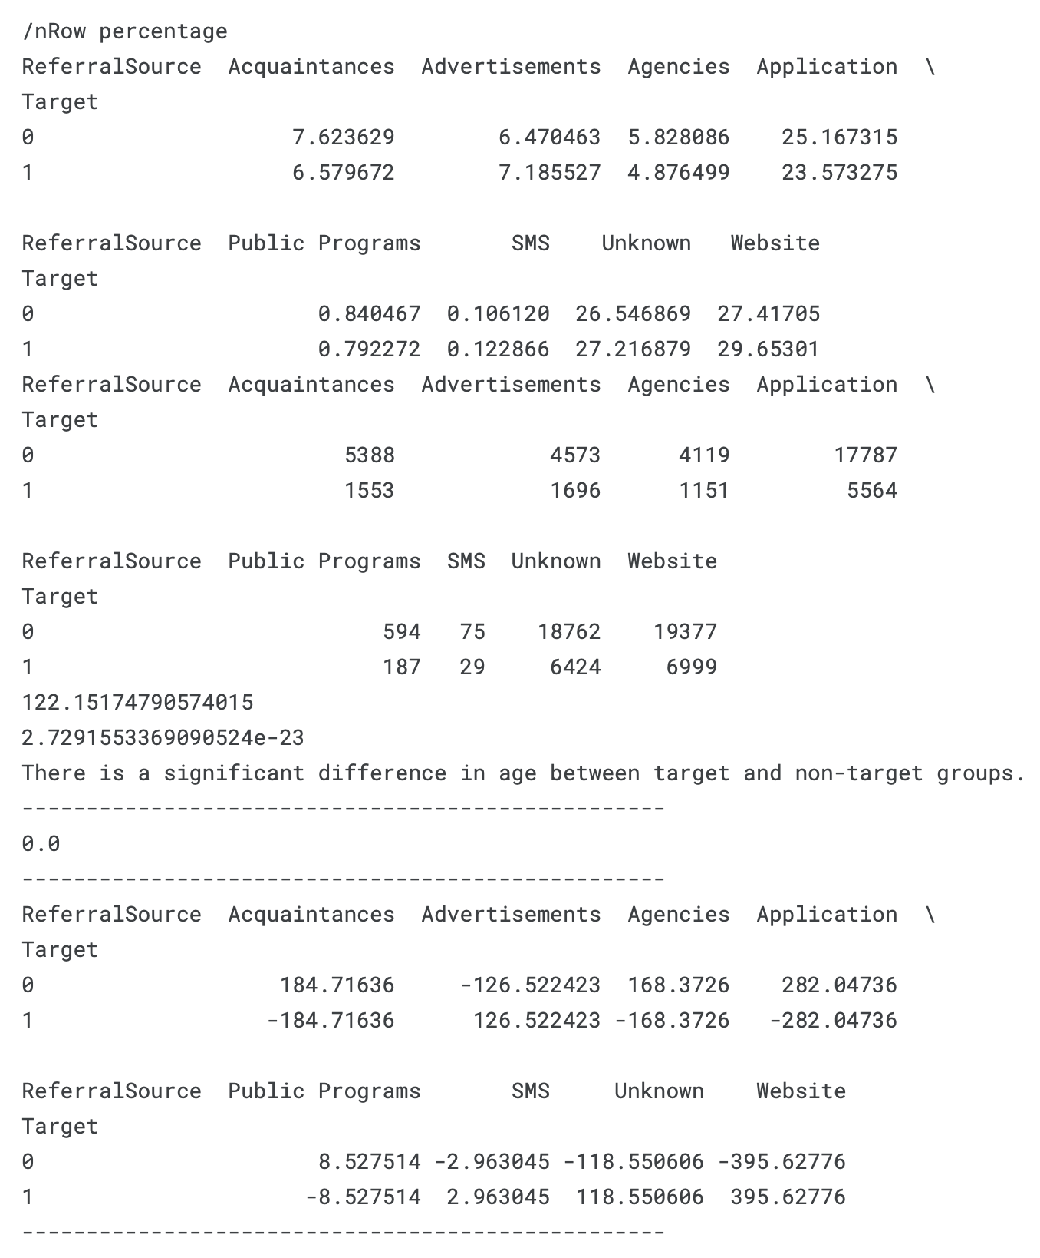
Test on referral source
Chi square test : 122.15
P-value : 2.73e-23
Residuals:
The observed vs. expected counts show deviations, particularly for categories such as:
Advertisements: Positive residuals for the target group and negative residuals for the non-target group.
Application: Higher than expected in both groups, but more so in the non-target group.
Website: Negative residuals for the non-target group and positive residuals for the target group.

Slide 22
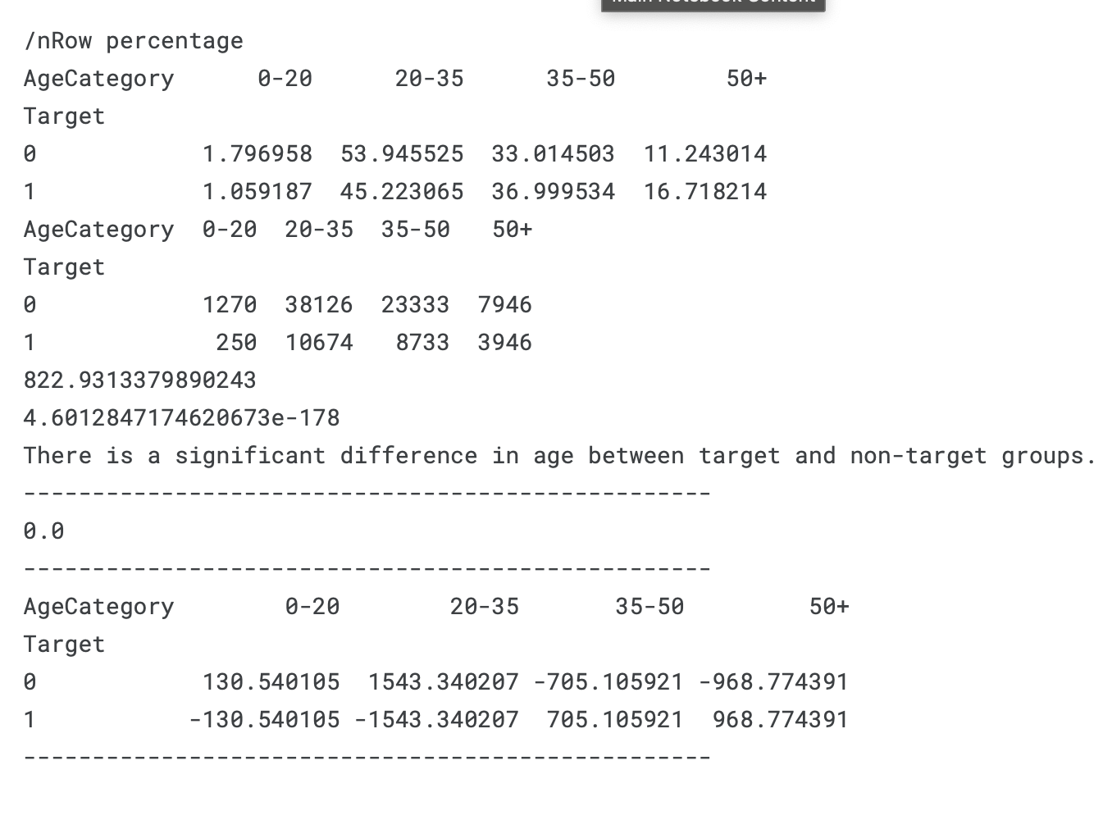
Test on Age category
Chi square test : 822
P-value : 4.60e-178
Potential for Regrouping:
Based on the residuals analysis, the following categories could be considered for regrouping or further investigation:
0-35 years: This group combines the younger age ranges and shows a higher proportion in the non-target group.
35+ years: This group combines older age ranges and shows a higher proportion in the target group.
Overall, the results indicate a significant association between age categories and the target variable, suggesting areas for potential regrouping and further analysis.

Slide 23
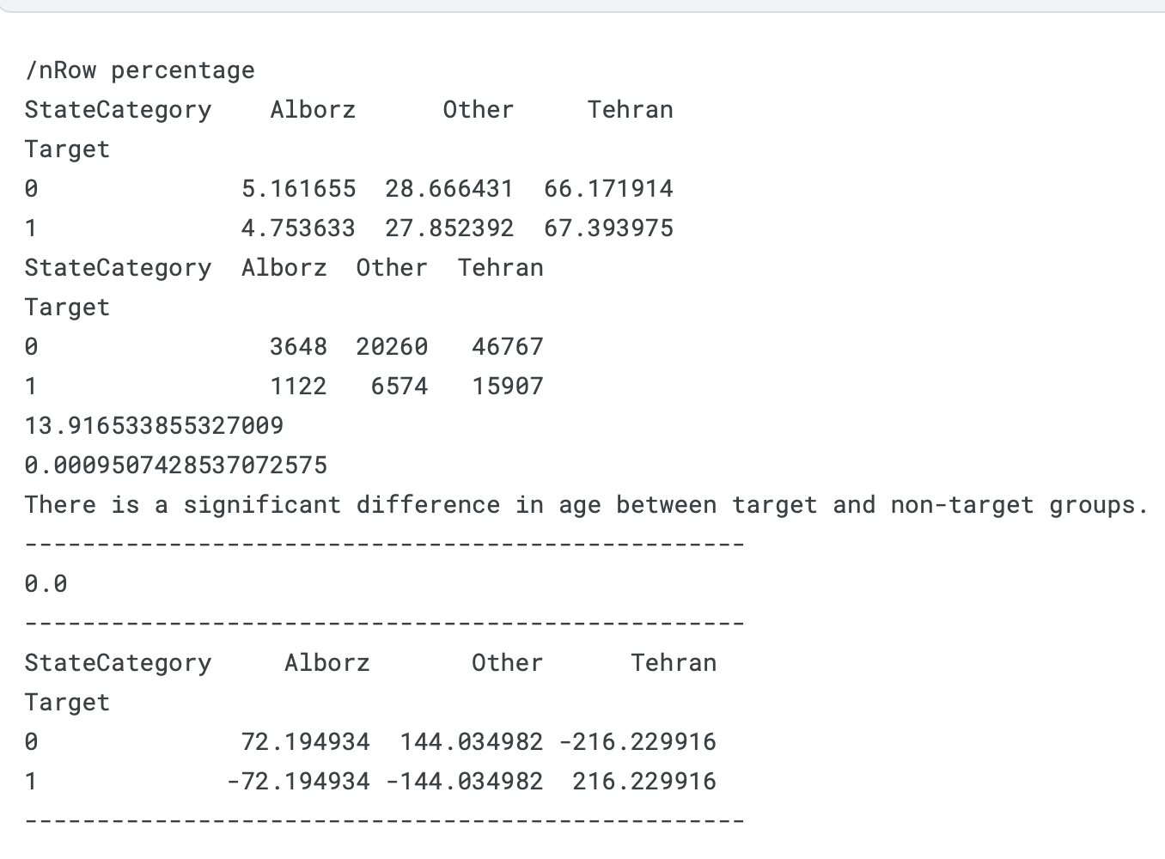
Test on state category
Chi square test : 13.92
P-value : 0.00095
The analysis shows a significant association between the State Category and the Target variable, indicating differences in state distribution between the target and non-target groups. The most notable deviations occur in the representation of individuals from Tehran, which is more prevalent in the target group, while the "Other" category has a higher representation in the non-target group. These findings suggest potential underlying factors related to geographic location that may influence the target status.

Slide 24
Decision tree
This code implements a Decision Tree Classifier using scikit-learn to predict a target variable based on categorical features. It also extracts decision rules from the trained model and calculates metrics such as support, confidence, and lift for each rule.
This code provides a comprehensive approach to building a decision tree model, extracting interpretable rules, and evaluating those rules using relevant metrics. However, it lacks a train-test split, which is important for assessing the accuracy of the decision tree algorithm. Despite this limitation, the code can still be useful in understanding the decision-making process of the model and deriving actionable insights from the data.
Decision tree max depth is 4, class wight 1 : 5 and criterion is entropy

Slide 25
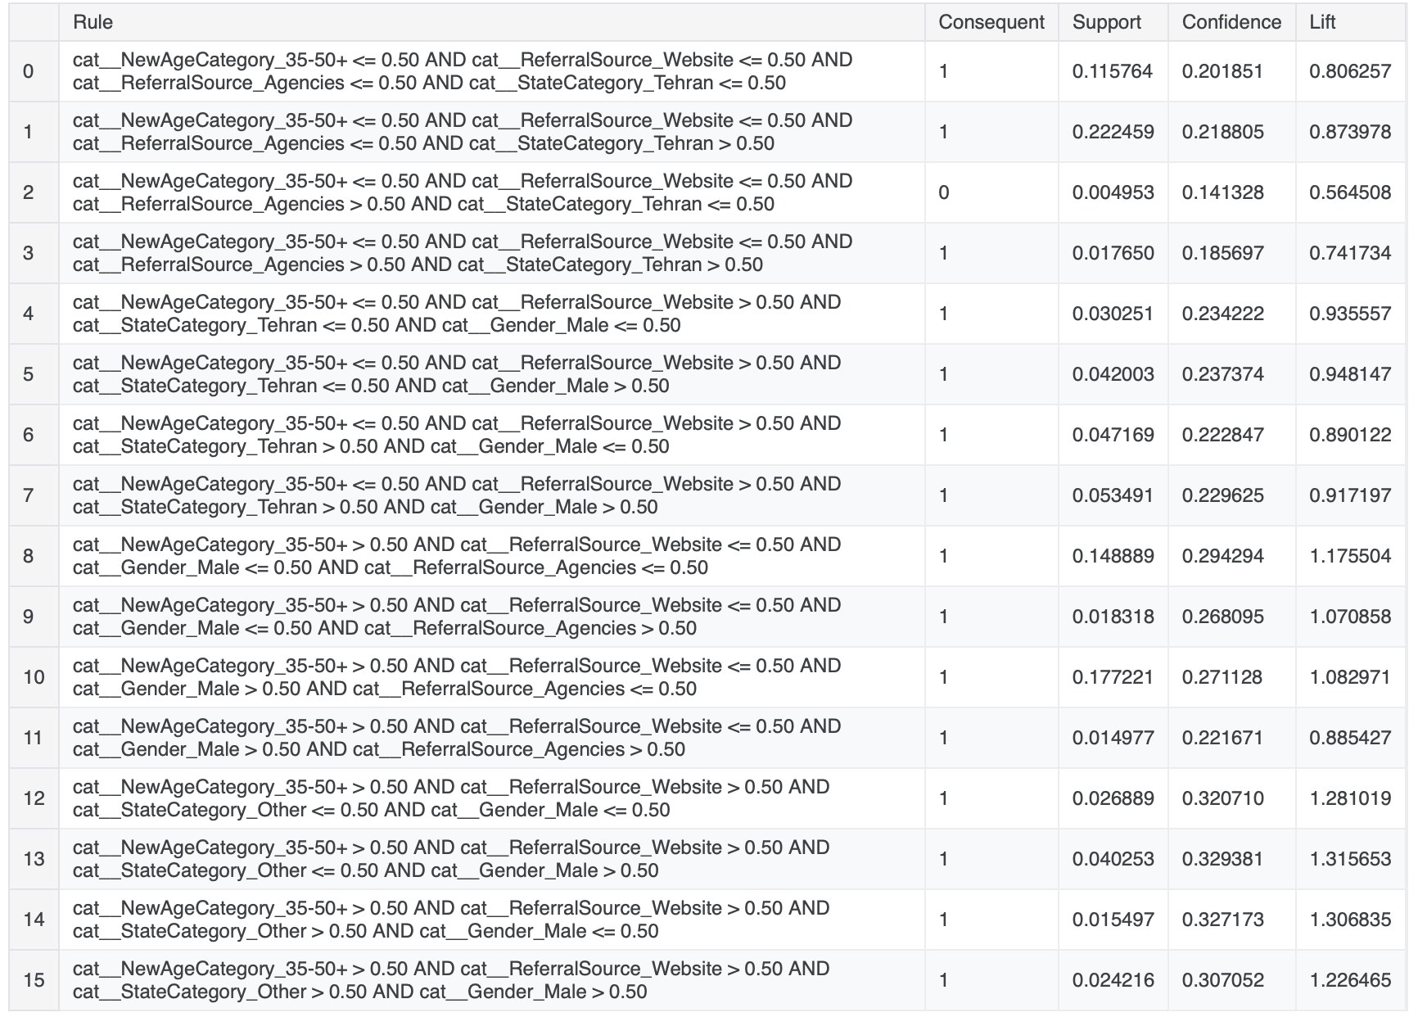
Decision tree rules
Based on the decision tree results, here’s a summary of customer characteristics that show high lift and can guide your advertisement campaign strategy for targeting the most valuable customers

Slide 26
conclusion
Referral Source: Website + State Category ”Tehran or Alborz":
Rule 12: female customers aged above 35-50+, from the ”Tehran or Alborz" state category, who use the website as their referral source, show a lift of 1.281
with a confidence of 0.321.
Rule 13: Male customers aged above 35-50+, from the " Tehran or Alborz " state category who use the website as their referral source, also show a lift of 1.316 with a
confidence of 0.329.
State Category "Other":
Rule 14: female customers aged above 35-50+ from the "Other" state category, who use the website as their referral source, show a lift of 1.307
with a confidence of 0.327.
Rule 15: Male customers aged above 35-50+ from the "Other" state category show a lift of 1.226 with a confidence of 0.307.
Gender and Age:
Rule 8: female customers aged above 35-50+ who do not rely heavily on website or agency referrals have a lift of 1.175 with a confidence of 0.294.

Slide 27
conclusion
General Patterns for Valuable Customers:
Age: Customers aged 35-50+ show a higher likelihood of being valuable.
Gender: Both male and female customers can be valuable, but the decision tree identifies gender-specific behaviors.
Referral Source: While website referrals play a significant role for older customers, those who don’t rely on the website but fall into other criteria can also be valuable.
Location: Both Tehran and non-major regions like “Other” have valuable customer segments, depending on other characteristics like age and referral source.
Conclusion:
Valuable customers (those classified as Target = 1) tend to be:
Middle-aged (35-50+).
More likely to rely on website referrals or be referred through non-standard channels (e.g., not agencies).
Both male and female, with gender-specific referral patterns.
Coming from both major cities like Tehran and less prominent regions, depending on their other behaviors.
These insights suggest targeting campaigns focusing on website channels for middle-aged customers and tailoring strategies based on regional differences.

